Slide 1

Introduction to Computer Science: Programming Methodology
Tutorial 5
Functions
朱翔宇
220019187@link.cuhk.edu.cn
Tutorial: 6-9pm Wed TD209
Office hour: 8-9am Wed Zhixin203B

Slide 2
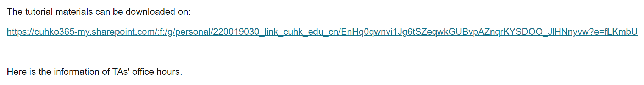
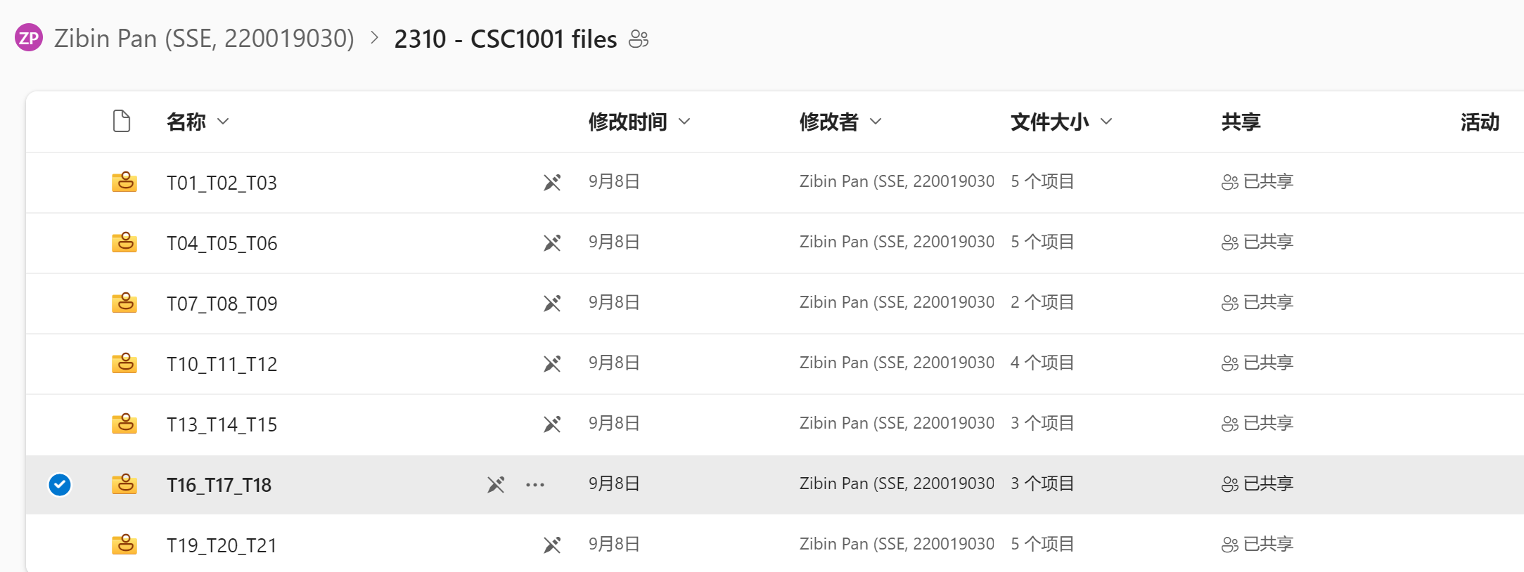
Download this slides and codes at:

Slide 3
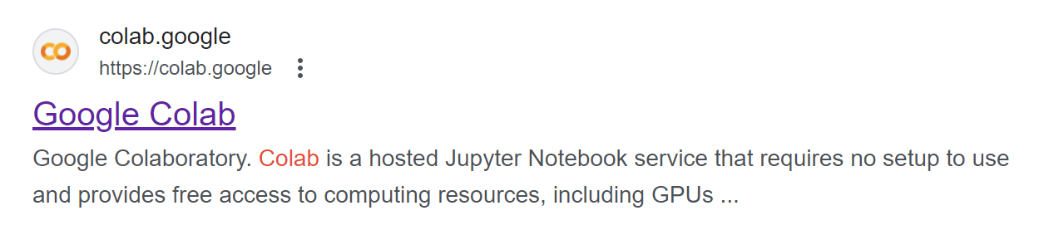
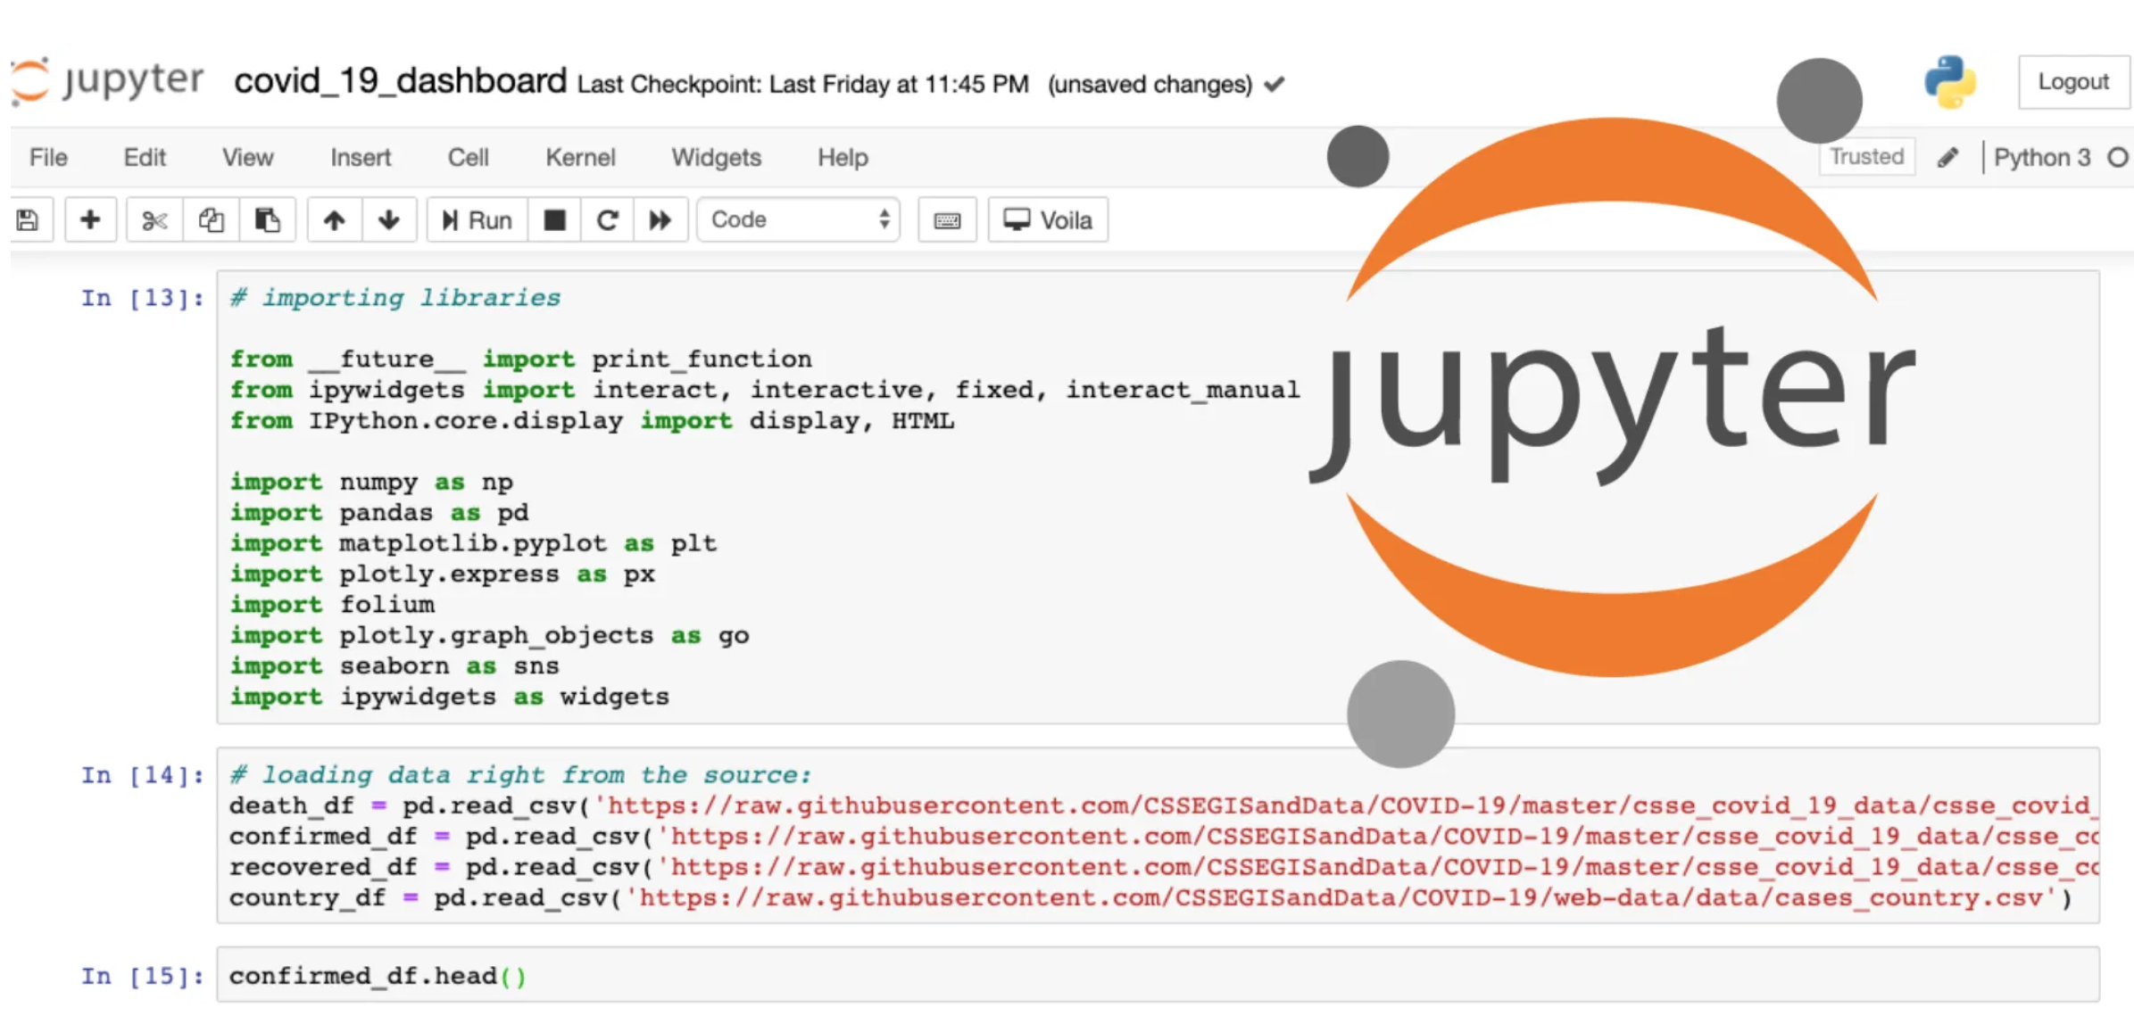
How to use .ipynb file?
Online: Google Colab
Offline: Jupyter Notebook(in Anaconda3)

Slide 4
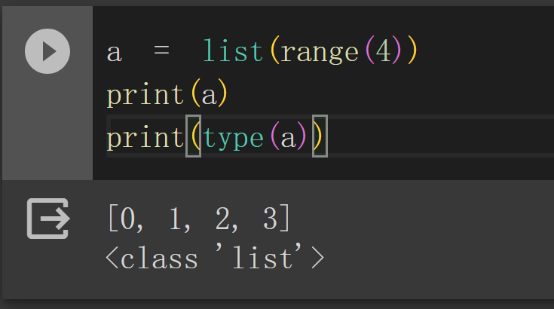
What to do in the tutorial .ipynb file?
Print value
Print type
Try different inputs, modify codes and check output

Slide 5
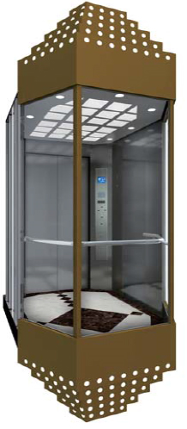
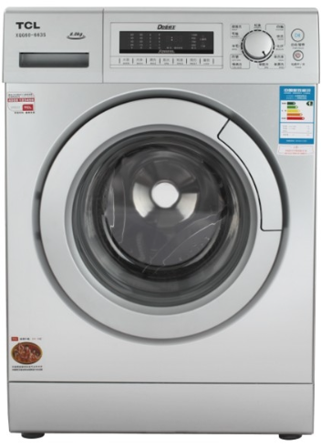
What is function?
Function is a package of code used to realize some specific functionalities or output some results of calculation.
Elevator-
Functionality: lift a number of people up to a certain floor.
Washing machine-
Input: dirty clothes
Ouput: clean clothes

Slide 6
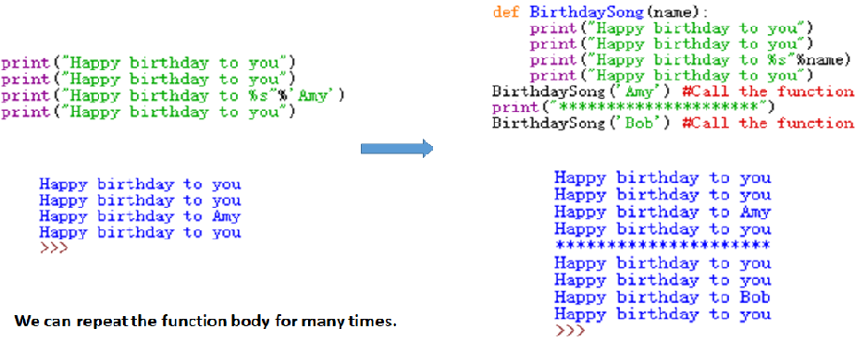
When to use function?-I
Motivations: 1. Repeatedly use the code, make it more efficient.
2. Realize specific functionalities.
3. Make communication between programmers more convenient.
4. Make the logic in your code more clear.
…
Example①:

Slide 7
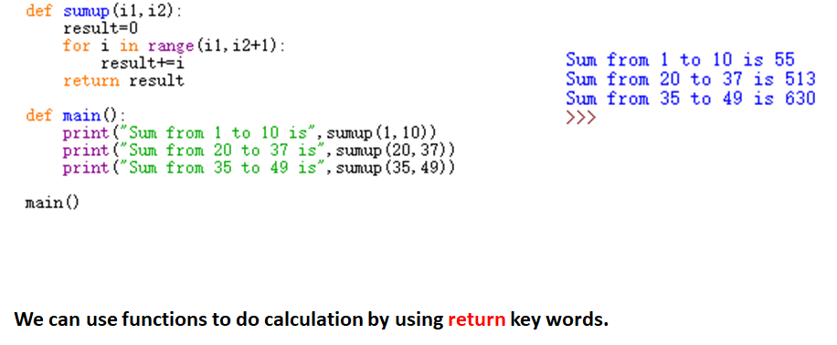
When to use function?-II
Example②:

Slide 8
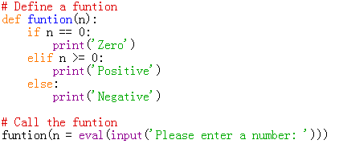

Function Definition-I
Program
Output
Define a function:
Parameter
Argument
An argument is a value we pass into the function as its input when we call the function
Call/Invoke a function:

Slide 9
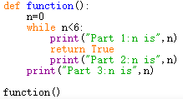
Function Definition-II
The return keyword-I
“A gift from function”
Return values
A fruitful function is one that produces a result(or return value)
The return statement ends the function execution and ‘sends back’ the result of the function
Output

Slide 10
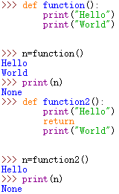
Function Definition-III
The return keyword-II
Void functions
When a function does not return a value, it is called a “void” function
When a function has no return statement, it will return None

Slide 11
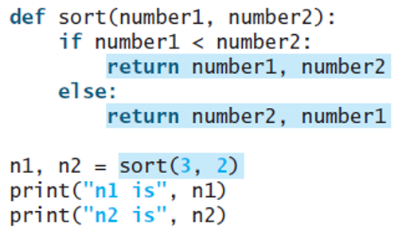
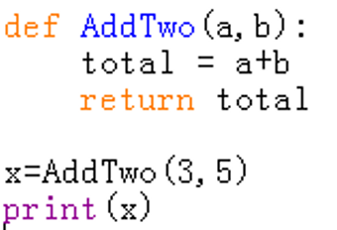
Function Definition-IV
Return multiple values
Multiple parameters/arguments
Match the number and order of arguments and parameters
When it is invoked, you need to pass the returned values in a simultaneous assignment

Slide 12
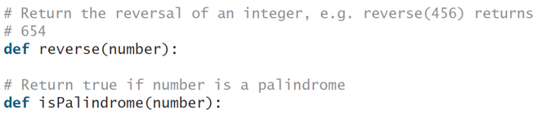
Q1: Palindrome Integers
Write the functions with the following headers:
Use the reverse function to implement isPalindrome. A number is a palindrome if its reversal is the same as itself. Write a test program that prompts the user to enter an integer and reports whether the integer is a palindrome.

Slide 13
Q2: Palindromic primes
A palindromic prime is a prime number that is also palindromic. For example, 131 is a prime and also a palindromic prime, as are 313 and 757. Write a program that displays the first 100 palindromic prime numbers. Display 10 numbers per line and align the numbers properly, as follow:

Slide 14
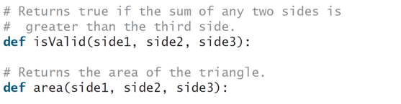
Q3: Mytriangle module
Create a module named MyTriangle that contains the following two functions:
Write a test program that reads three sides for a triangle and computes the area if the input is valid. Otherwise, it displays that the input is invalid.

Slide 15
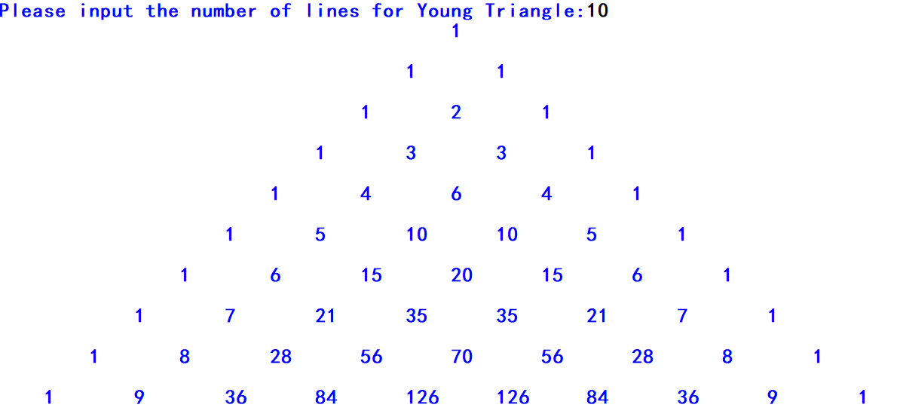
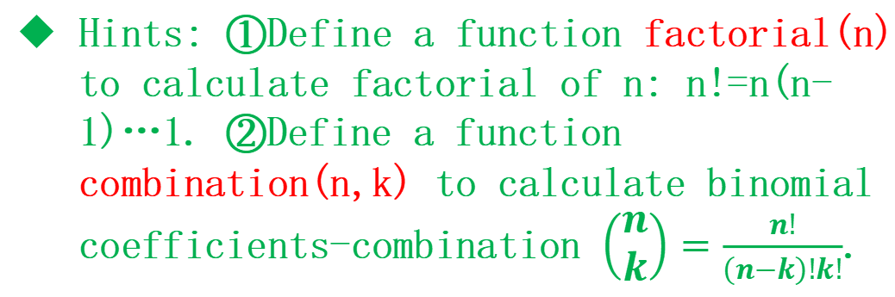
Q4: Yang Hui’s Triangle
Yang Hui’s Triangle(Pascal’s Triangle) is a triangle with numbers where each of them in one line equals to the sum of the two neighbor numbers in previous line. Equivalently, it is a triangular array of the binomial coefficients. Write a program to print Yang Hui’s Triangle with given number of lines.
Hints: ①Define a function factorial(n) to calculate factorial of n: n!=n(n-1)…1. ②Define a function combination(n,k) to calculate binomial coefficients-combination $\left(\begin{matrix}n \\ k\end{matrix}\right)=\frac{n!}{\left(n−k\right)!k!}$.

